Slide 1
AWS DEVOPS Services
- Ravi Kulkarni

Slide 2
Introduction to different awS SERVICES
AWS CodePipeline: A continuous delivery service that automates the steps required to release your software changes continuously.
AWS CodeBuild: A fully managed build service that compiles source code, runs tests, and produces software packages that are ready to deploy.
AWS CodeDeploy: A deployment automation service that helps you deploy code to any instance, including Amazon EC2 instances and on-premises servers.

Slide 3
AWS CloudFormation: A service that helps you create and manage infrastructure as code.
AWS OpsWorks: A service that helps you automate the configuration, management, and deployment of your applications.
AWS Lambda: A serverless compute service that lets you run code without provisioning or managing servers.
AWS X-Ray: A service that helps you debug and troubleshoot your applications.
AWS CodeStar: A service that helps you create and manage CI/CD pipelines for your AWS projects.

Slide 4
AWS CODEPIPELINE
AWS CodePipeline is a continuous delivery service that automates the steps required to release your software changes continuously.
It can be used to automate the deployment of code to a variety of targets, including Amazon EC2 instances, AWS Lambda functions, and Amazon ECS services.

Slide 5
How CoDEPIPELINE WORKS?
CodePipeline works by creating a pipeline, which is a sequence of steps that are executed when a change is made to your source code.
The steps in a pipeline can be anything from building your code to deploying it to production. CodePipeline can automatically trigger these steps based on events, such as a commit to your source repository or a new pull request.

Slide 6
USE CASES for CODEPIPELINE
some specific examples of how CodePipeline can be used:
A software company can use CodePipeline to automate the deployment of new features to their website.
A financial services company can use CodePipeline to automate the deployment of new compliance checks to their trading platform.
A retail company can use CodePipeline to automate the deployment of new marketing campaigns to their website.

Slide 7
Actions in CODEPIpELINE
Source: A source action is used to retrieve the source code for your pipeline. The source code can be retrieved from a variety of sources, such as Amazon S3, GitHub, and Bitbucket.
Build: A build action is used to build your source code. The build action can use a variety of build tools, such as Maven, Gradle, and ANT.
Test: A test action is used to test your source code. The test action can use a variety of testing frameworks, such as JUnit, Mocha, and Jasmine.

Slide 8
Actions in CODEPIpELINE
Deploy: A deploy action is used to deploy your code to a production environment. The deploy action can use a variety of deployment tools, such as AWS CodeDeploy, AWS Elastic Beanstalk, and AWS Lambda.
Approval: An approval action is used to get approval before deploying your code to a production environment. The approval action can use a variety of approval mechanisms, such as Amazon SNS, Amazon SQS, and Amazon Simple Email Service (SES).
Invoke: An invoke action is used to invoke a Lambda function. The invoke action can be used to trigger a variety of events, such as a code change, a schedule, or a manual invocation.

Slide 9
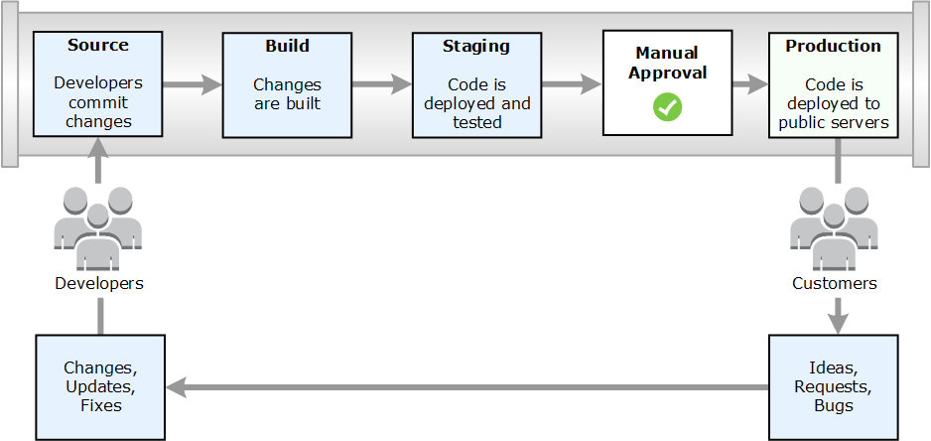

Slide 10
AWS CODEBUILD
CodeBuild is a fully managed build service that compiles source code, runs tests, and produces software packages that are ready to deploy.
CodeBuild eliminates the need to provision, manage, and scale your own build servers.

Slide 11
Build phases are the different stages of a build process. The most common build phases are:
install: This phase is used to install the dependencies for your project.
pre_build: This phase is used to run any pre-build tasks, such as running linters or static analysis tools.
build: This phase is used to build your project.
post_build: This phase is used to run any post-build tasks, such as running tests or deploying your project

Slide 12
Buildspec.yaml
The config file is a YAML file that specifies the configuration for your build project. The config file includes the following:
The source code that you want to build
The build environment, which is a pre-configured set of tools and software that CodeBuild uses to build your code
The build commands, which are the instructions that CodeBuild executes to build your code
The build artifacts, which are the output of the build process

Slide 13
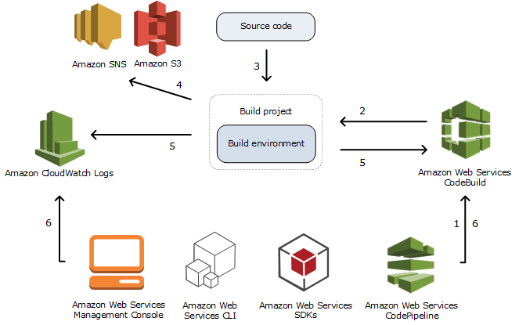

Slide 14
AWS CODEDEPLOY
WS CodeDeploy is a deployment automation service that helps you deploy code to a variety of compute services, such as Amazon EC2 instances, AWS Lambda functions, and Amazon ECS services.
CodeDeploy can automate the deployment of a nearly unlimited variety of application content, including:
Code
Serverless AWS Lambda functions
Web and configuration files
Executables
Packages

Slide 15
features of AWS CodeDeploy
Deployment groups: A deployment group is a collection of instances that you want to deploy to.
Deployment configurations: A deployment configuration is a set of instructions that CodeDeploy uses to deploy your code.
Deployment policies: A deployment policy is a set of rules that CodeDeploy uses to determine how to deploy your code.
Deployment reports: A deployment report is a record of the deployment process.

Slide 16
AWS codestar
AWS CodeStar is a service that helps you quickly and easily create, build, and deploy applications on AWS. CodeStar provides a unified user interface, enabling you to easily manage your software development activities in one place.
With CodeStar, you can set up your entire continuous delivery toolchain in minutes, allowing you to start releasing code faster.

Slide 17
CodeStar includes a number of features that make it easy to get started with AWS:
Project templates: CodeStar provides a number of project templates that you can use to get started quickly. These templates include everything you need to create a complete application, including a starter code repository, a build pipeline, and a deployment pipeline.
Project management dashboard: CodeStar provides a project management dashboard that you can use to track the progress of your project. The dashboard includes information about your source code, build pipeline, deployment pipeline, and environment.
Integrated issue tracking: CodeStar integrates with Atlassian JIRA Software, so you can easily manage issues for your project.
CodeStar Connections: CodeStar Connections enables you to connect to other AWS services, such as CodeBuild, CodePipeline, and CodeDeploy. This makes it easy to automate your CI/CD workflow.

Slide 18
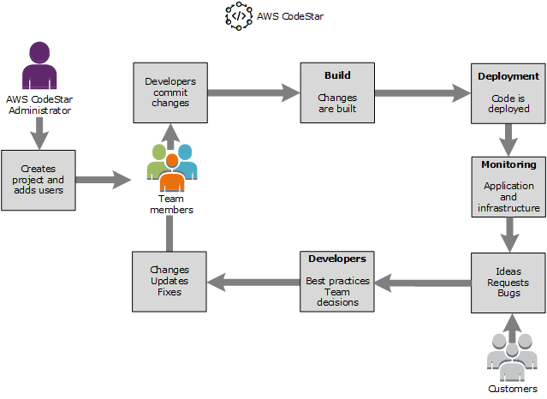

Slide 19
references
https://docs.aws.amazon.com/codepipeline/latest/userguide/welcome-introducing.html
https://docs.aws.amazon.com/codebuild/latest/userguide/concepts.html
https://docs.aws.amazon.com/codestar/latest/userguide/working-with-projects.html

